Slide 1
Synthetic control methods
Dr Xingna Zhang

Slide 2
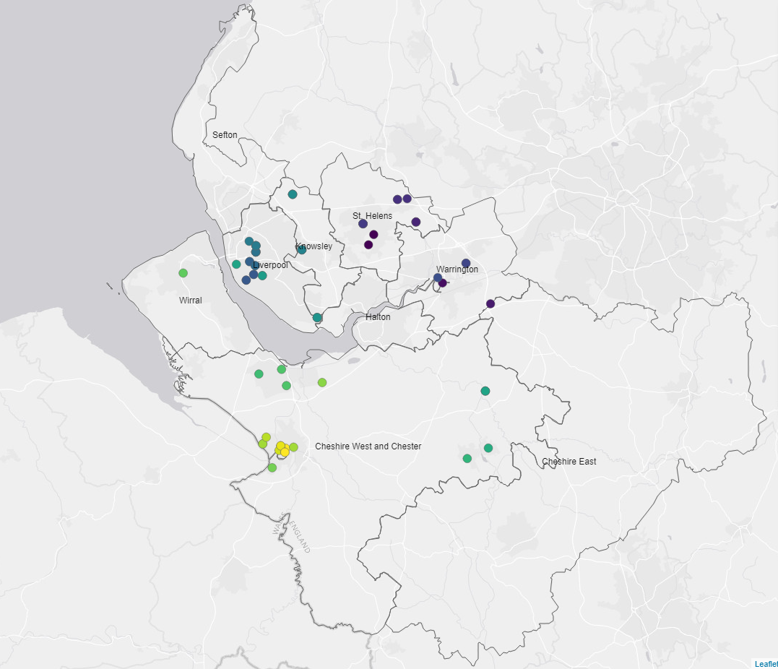
What are synthetic control methods?
A statistical method used to estimate causal effects of interventions.
Combines data from multiple control units to create a "synthetic" version of the treatment group.
Mobile vaccination sites within Cheshire & Merseyside

Slide 3
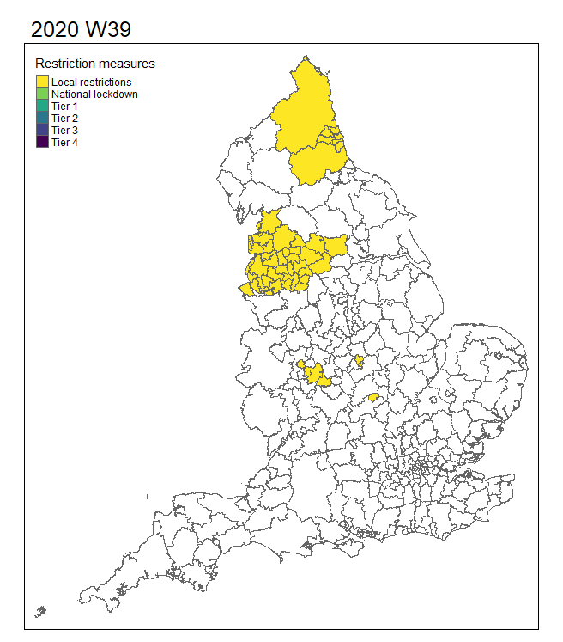
Randomised controlled trial
Natural experiments
VS
Source: https://www.shutterstock.com/search/control-group

Slide 4
Mathematical formulation
Average treatment effect (ATE):
$$E\left[Y\left(1\right)\right]−E[Y(0)]$$
Where 1/0 are the intervention implemented/not implemented.
Y is the outcome variable.
Formal mathematical formulation

Slide 5
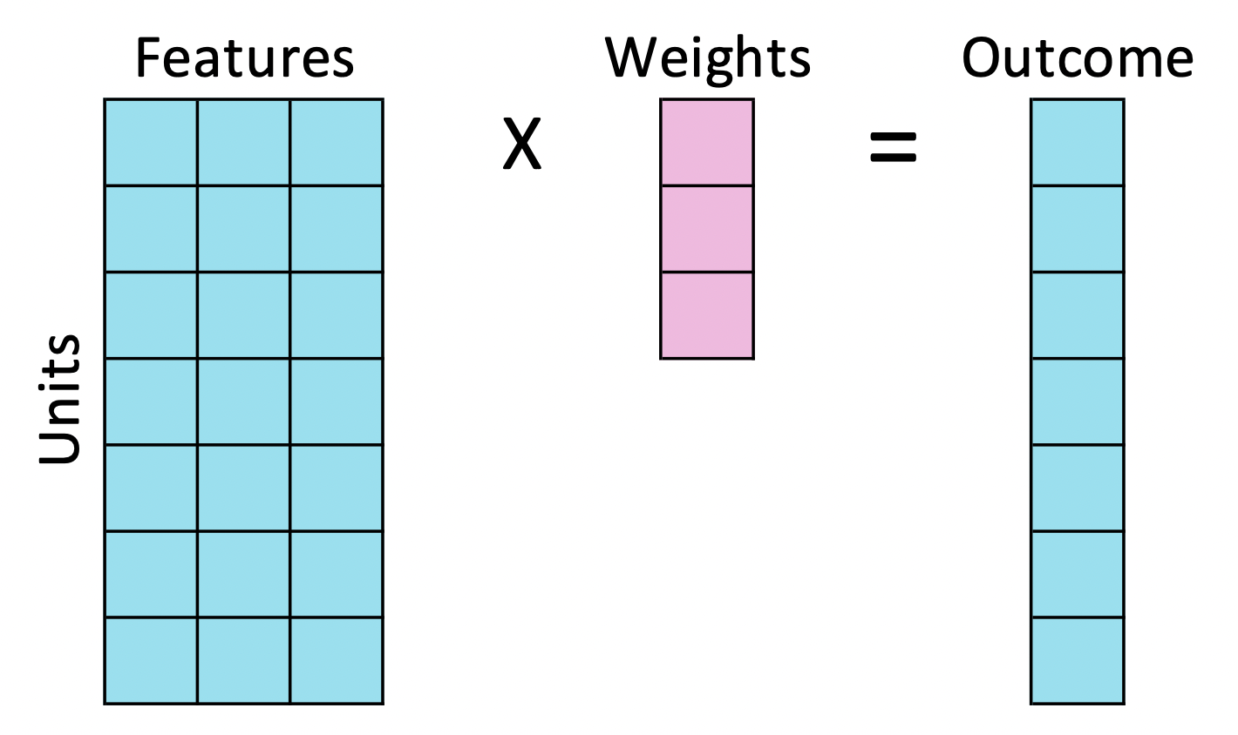
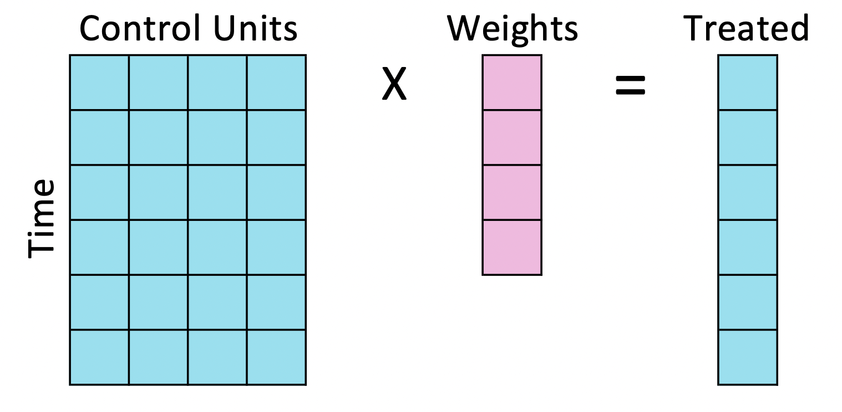
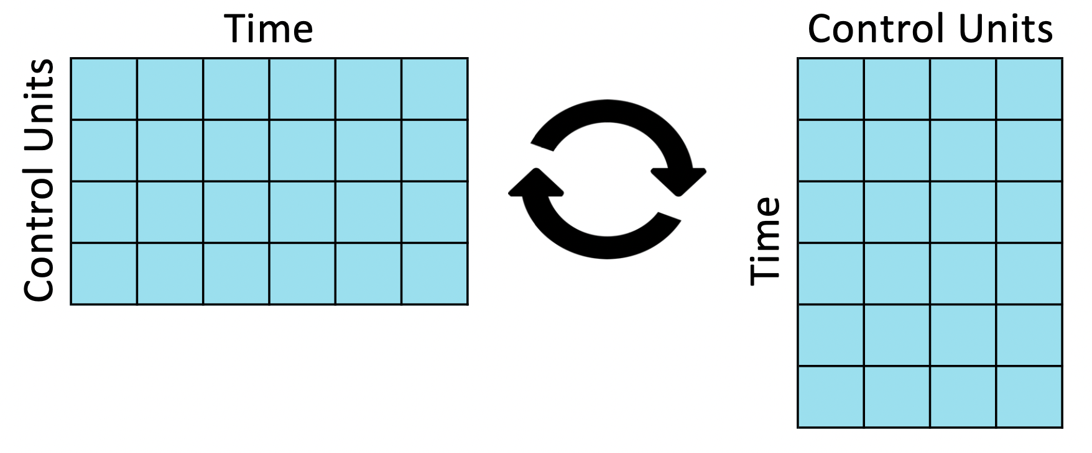
Linear regression
Construct the synthetic control
Transpose the data for synthetic control
Source: Understanding Synthetic Control Methods | Matteo Courthoud

Slide 6
Case study I:
COVID-19 mobile vaccination units across the Cheshire and Merseyside region in 2021
https://bmjopen.bmj.com/content/13/10/e071852

Slide 7
Synthetic control design
Match intervention cohort with control cohort with similar trend in vaccine uptake.
Model the change in weekly uptake after the introduction of the mobile vaccination units.

Slide 8
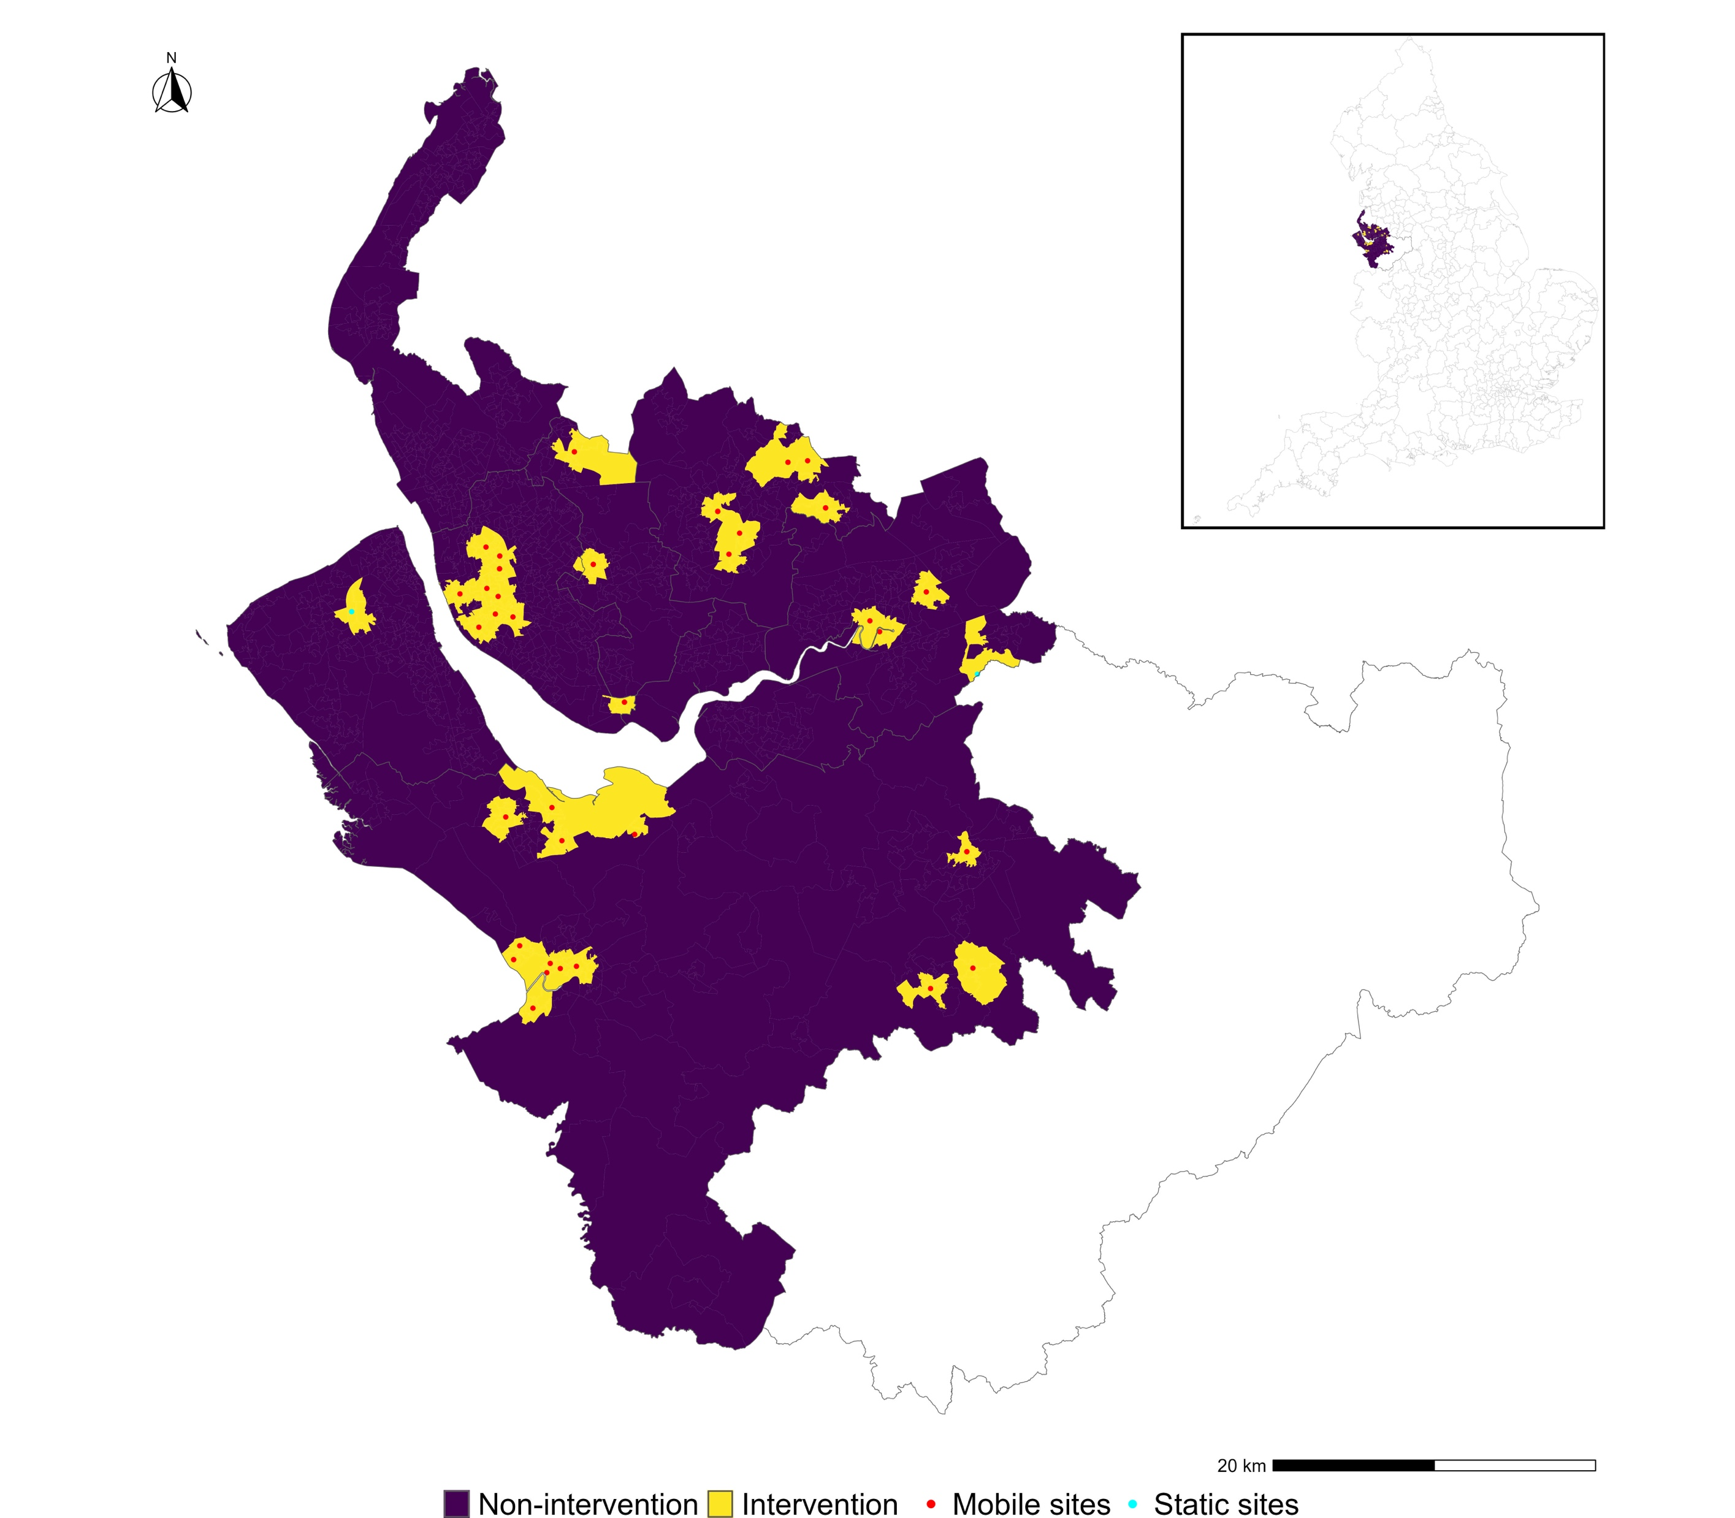
Defining exposed/ intervention LSOA cohort
Lower Super Output Area (LSOA) within radius (1 km) of the mobile vaccination site.
LSOA weighted centroids.
Exposure.
Mobile vaccination units that visited 37 sites on 54 occasions.
First dose, 12th April – 28th June 2021.
7 weeks before and 3 weeks after the exposure start date.
Matching variables.
Demographics.
Socio-economics.
Vaccine access.
Neighbourhood characteristics.

Slide 9
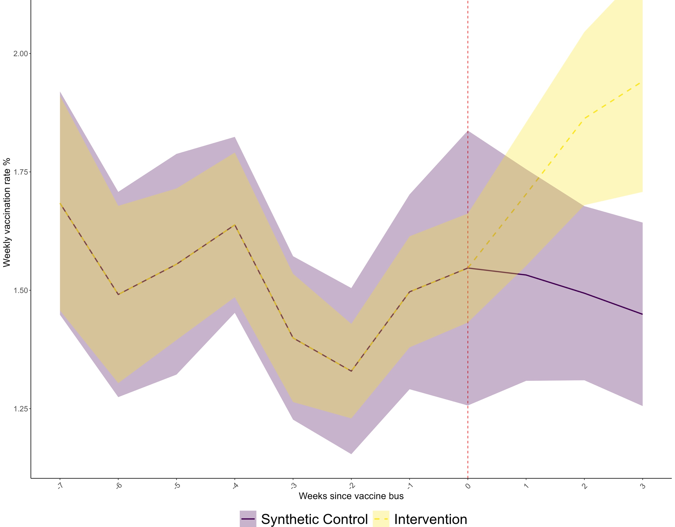
Results
The trend in the weekly vaccination rate with their 95% confidence intervals in the intervention and synthetic control areas. Outcome: a 25% (95% CI 21% to 28%) increase in uptake within 3 weeks after first deployment.

Slide 10
Case study II:
Evaluating the impacts of tiered restrictions introduced in England, during October and December 2020 on COVID-19 Cases
https://bmjopen.bmj.com/content/12/4/e054101

Slide 13
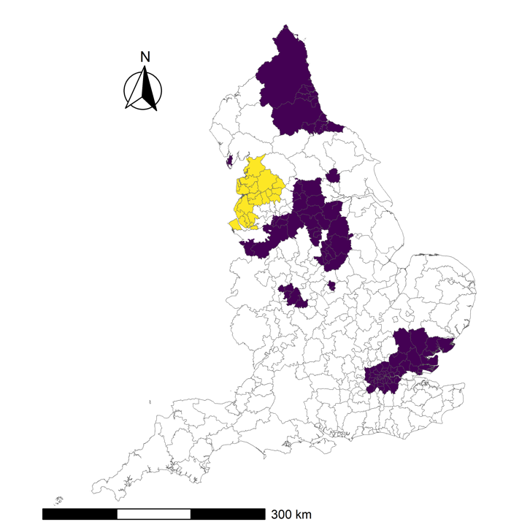
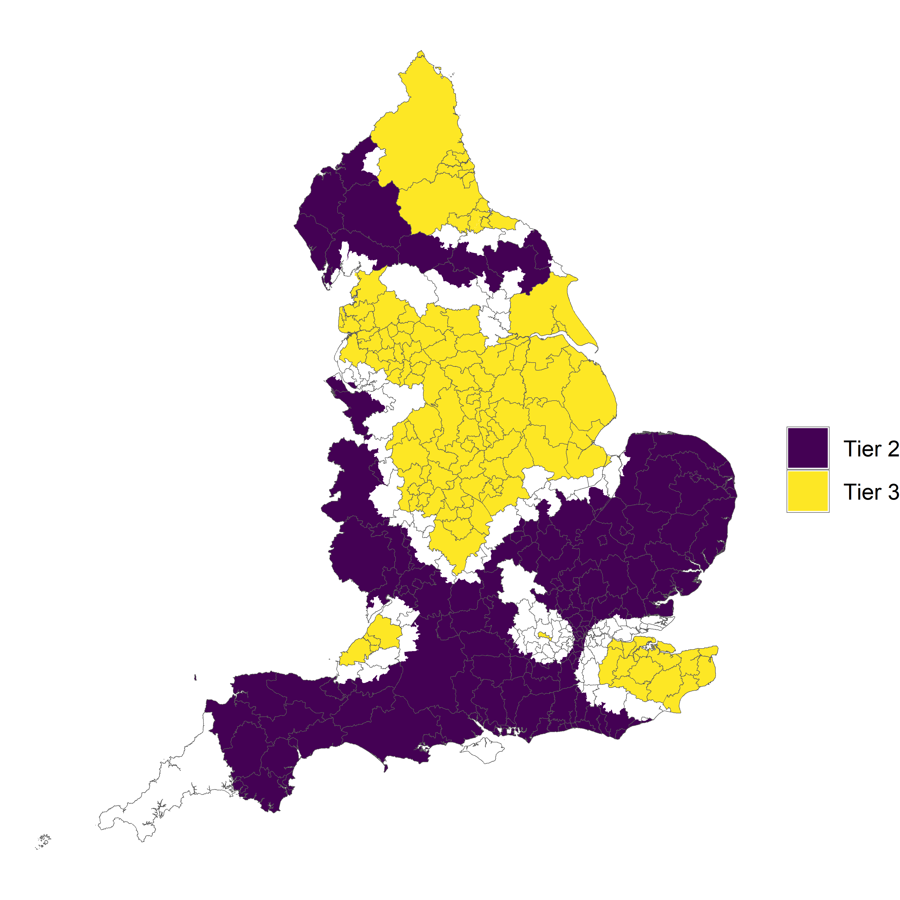
Sensitivity test
October
December

Slide 14
Strengths and limitations
Ethical considerations
Data requirements
panel data
pre- and post-intervention periods
large and representative donor pool
Methodological assumptions
no anticipation
no interference (spillover)
common support
homogeneous treatment effect across units/ time
endogenous treatment assignment
no unmeasured time-varying confounders
https://www.bmj.com/content/379/bmj.o2712

Slide 15
www.ncrm.ac.uk

